Slide 1
Performance Management and Capacity Planning using PAWZ
PerfCap Corporation
76-39 Northeastern Blvd.,, Nashua, NH 03062
www.PerfCap.com; Info@PerfCap.com; 603-594-0222

Slide 2
PerfCap Corporation A Software Product Company
Group Started within Digital/Compaq (now HP) over 25 years ago
Operating as independent corporation since 2001
Privately Owned, Zero Debt
Currently focused on Performance Monitoring, Capacity Planning and Asset Management
20+ Years of Solid Engineering & Development
Worldwide Presence
HP and other resellers continue to sell it world wide
Partnership
HP, IBM, Oracle/SUN, VMware
Dell, Microsoft Certified Partner

Slide 3
Some of PerfCap Customers
ThomsonReuters Enterprise License – Unlimited use (50,000+ deployed)
BNP Paribas (4th Largest Retail Bank in Europe) Enterprise License – Unlimited use (3000+ deployed)
Detusche Bank Site License – (2000 Servers)
US Postal Services Monitoring 450 Servers
Barclays UK
Commerzbank
Douches Bank UK
SIAC
Mary Kay
Certegy
Analog Devices
Royal Bank of Scotland
International Papers
Vodafone
British Telecom
MDS Pharmacy
Pfizer
Qwest
Lockheed Martin
Caremark
Swedish Customs
Netherlands Army
CNS Dubai
UPMC Medical Center
UIC Medical Center
University Hospital, Zurich
US Dept. of Education
SUNY Buffalo Univ.

Slide 4
PerfCap Software Offering
Performance Management
Server Performance - PAWZ
Web Application Transaction Performance - WAT
Capacity Planning
PAWZ Planner
Asset Management
Hardware, Software, Patches, etc., - FindIT

Slide 5
PerfCap Software Offering Performance Management
Challenges
Scaling – hundred to thousands servers
Automated
“Need-to-Know” Basis
Any Time, Anywhere – everything web based
Server Performance Reporting
Real Time
Near Time
Historical
Web Application Transaction Monitor

Slide 6
PerfCap Software Offering Capacity Planning
Definition:
A process to determine how much computing resources are required to meet business growth
Or
How much business can grow before some device will run out of capacity
To answer “What if” questions like:
Can my current configuration handle three times of current workload – when will my current configuration saturate
What will be impact of a new application on current system performance
What will be impact of upgrading a current server or adding a new server
Can I reduce the number of servers without violating my “Service Level Agreement” – a.k.a. Server Consolidation

Slide 7
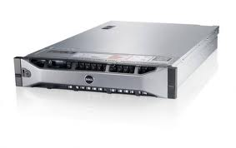
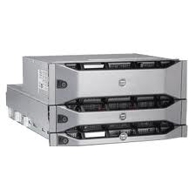
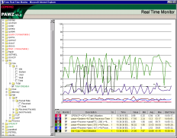
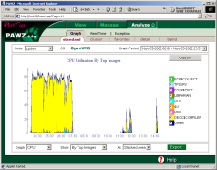
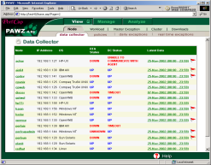
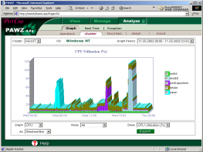
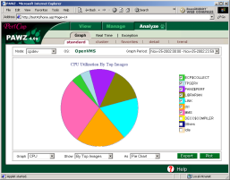
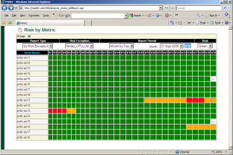
Measure Real Workload
Measure workload resource demands
Determine workload behavior pattern
Analysis/modelling Engine & Datastore
Applications
Web
Daily uploads
Intranet
Array Console
Storage Arrays
Notifications
Remote D/C
Real Time
Performance/Capacity
Graphs
CloudView
hypervisors or vCenter
Reports & Exports
Applications
Physical Servers
Events
Clusters
VMs, EC2, …
Networks Storage
Risk Dashboards

Slide 8
PAWZ Components
PAWZ Agent/Monitor: Resides on each node to be monitored
Collect Performance data 24x7
Send collected data to PAWZ Server in real time and/or once a day
PAWZ Server: Resides on a Windows based server and communicates with hundreds of PAWZ Agents
Receives data from PAWZ Agent
Processes and produces real time, daily and historical charts and reports
Produces trend graphs for simple projections
Runs a queuing network modeler for capacity planning
PAWZ Browser: Resides on any corporate desktop
Shows all reports and charts within Internet Browser
Manage most of PAWZ functions

Slide 9
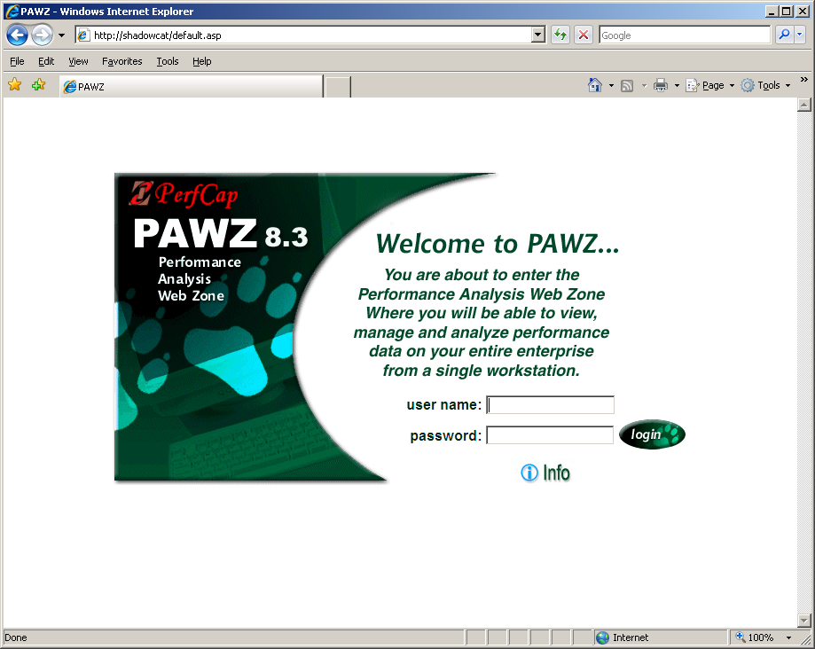
PAWZ Home Page
Different Users can be assigned different privileges, groups of systems they can see etc.

Slide 10
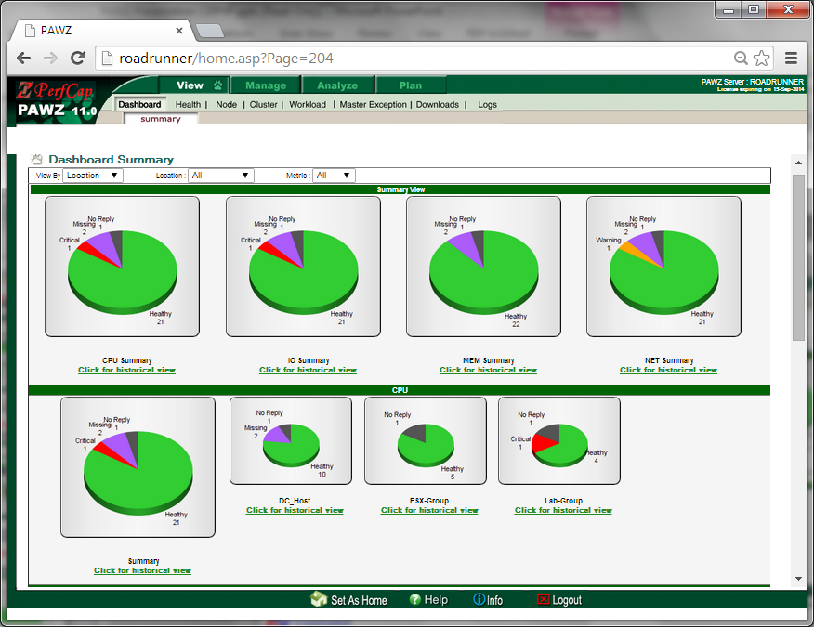
PAWZ Dashboard

Slide 11
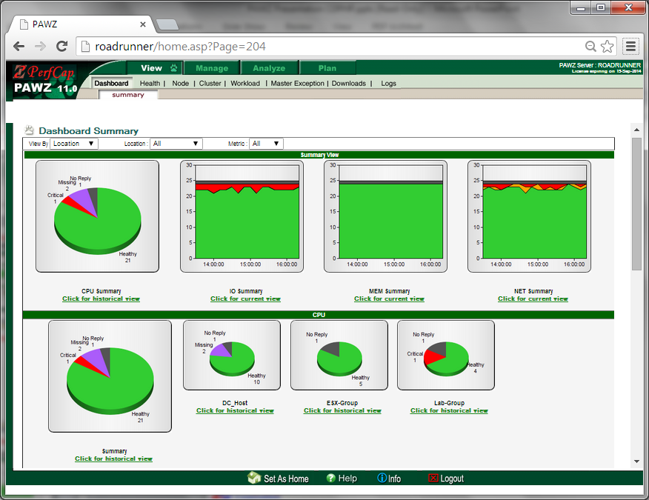
PAWZ Dashboard

Slide 12
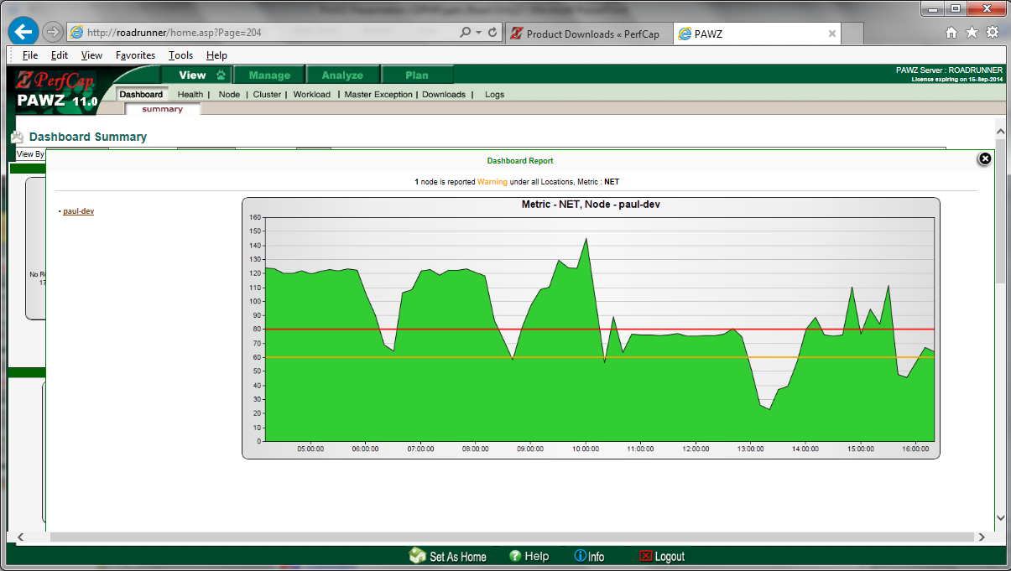
PAWZ Dashboard

Slide 13
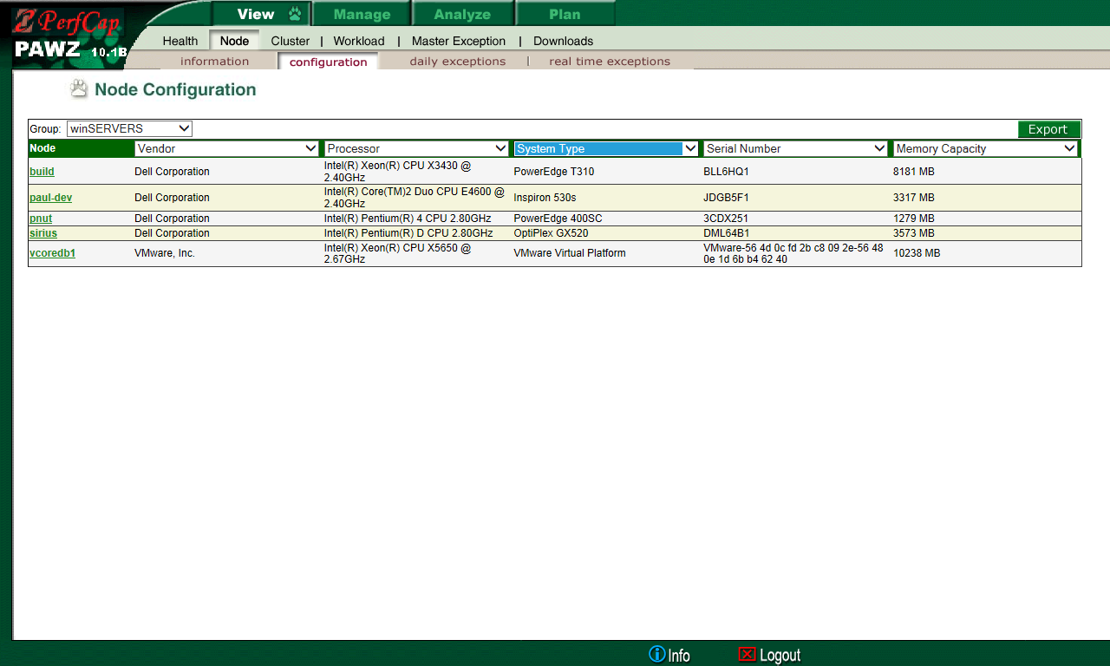
Client's Configuration

Slide 14
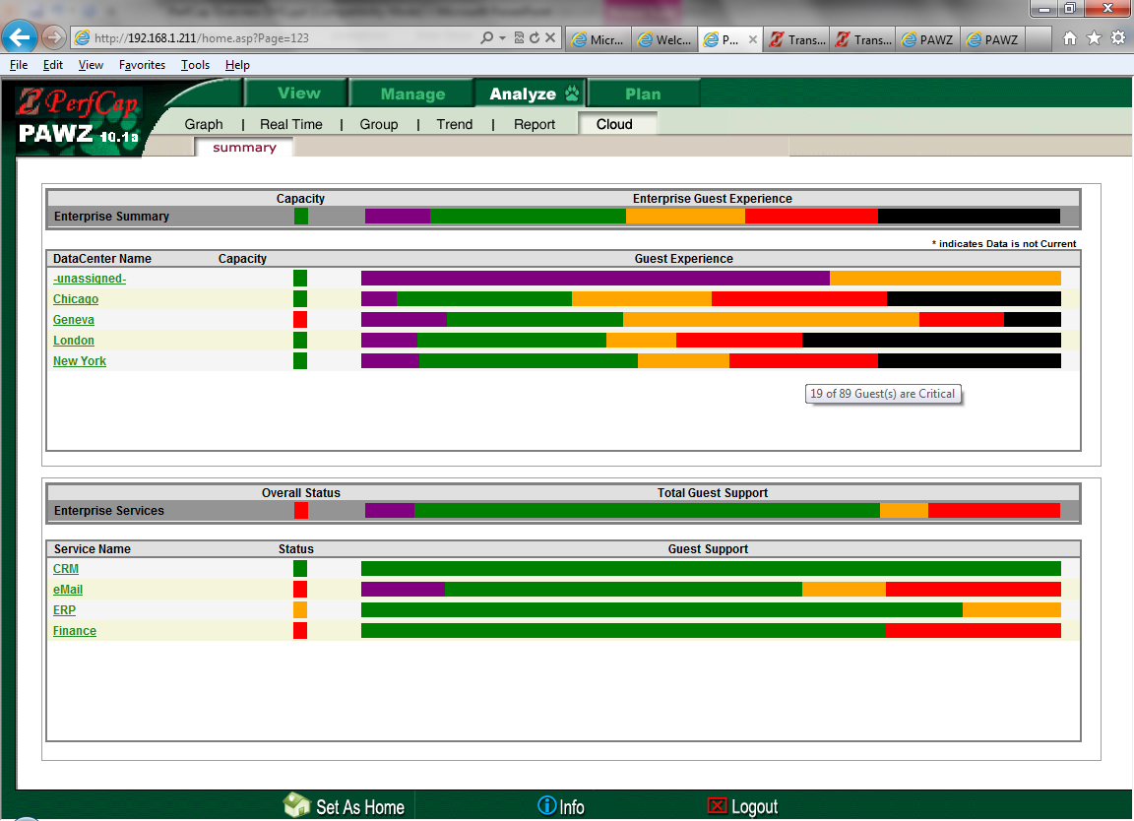
Cloud Daily Health Dashboard

Slide 15
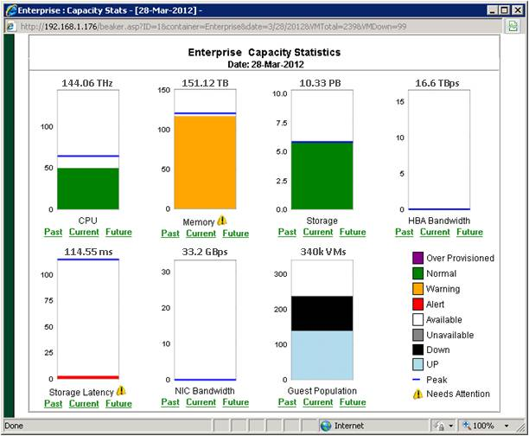
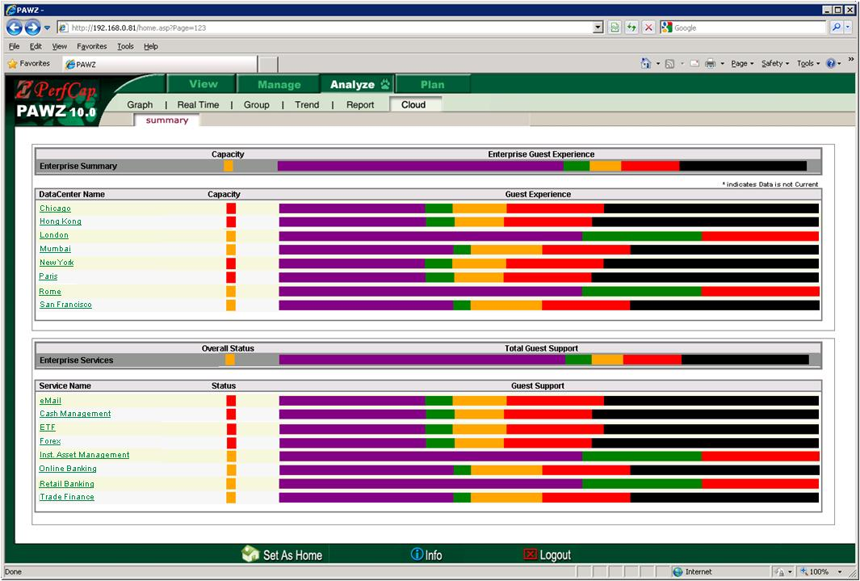
Capacity Statistics
Enterprise Capacity Statistics View
Enterprise View
Notes:
The Cloud View Status dashboard provides senior IT management with a visual representation (enterprise wide, department wide, cluster wide, etc.) regarding the current usage of resources and the spectrum of application performance experiences.
In the Enterprise View, the left column of colored icons indicates aggregated capacity status and level of utilization of CPU cycles, memory, storage, etc. The right bars indicates the number of guests in various states (normal, over provisioned, critical, down, etc.)
The lower part of the dashboard displays the capacity status and provisioning of server groups assigned to distributed applications or business departments.
The user may drill down into more detailed data, including past history, current profile, and projected resource utilizations as seen in the Enterprise Capacity Statistics View.
From this display a user may drill down to datacenter, cluster, individual hosts and guest levels as well as obtain detailed advice where provisioning is not optimal.

Slide 16
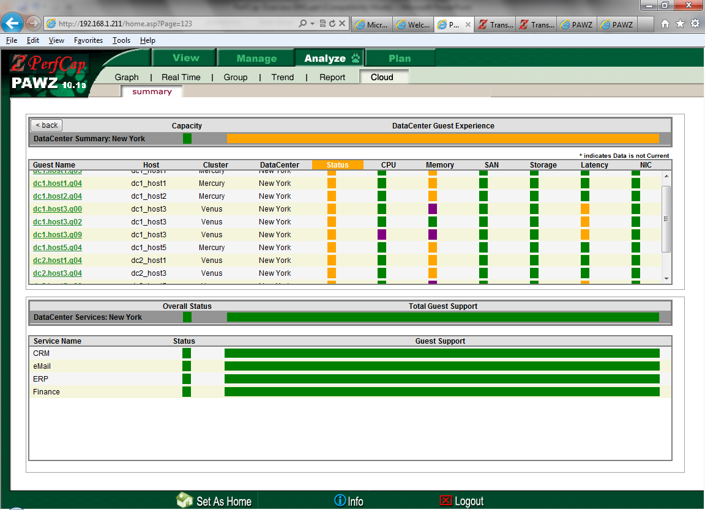
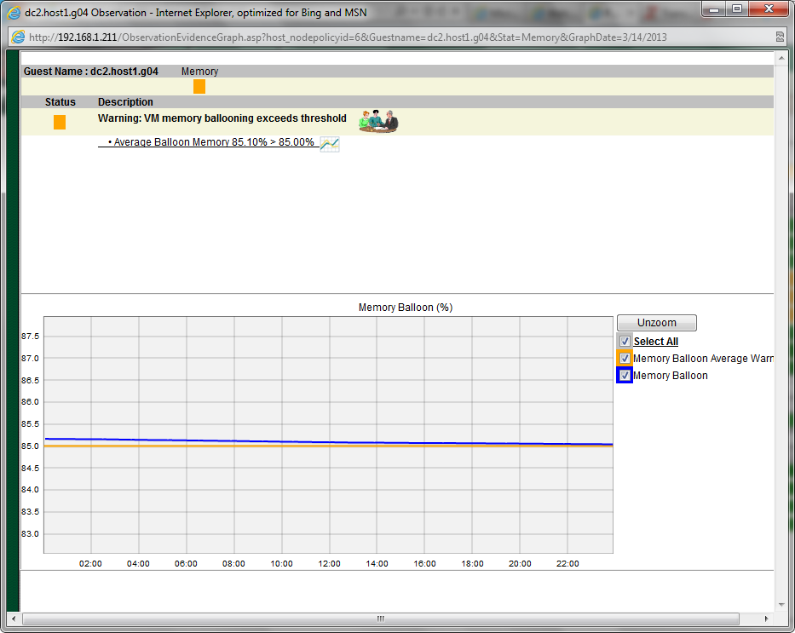
Critical Guests in a Data Center

Slide 17
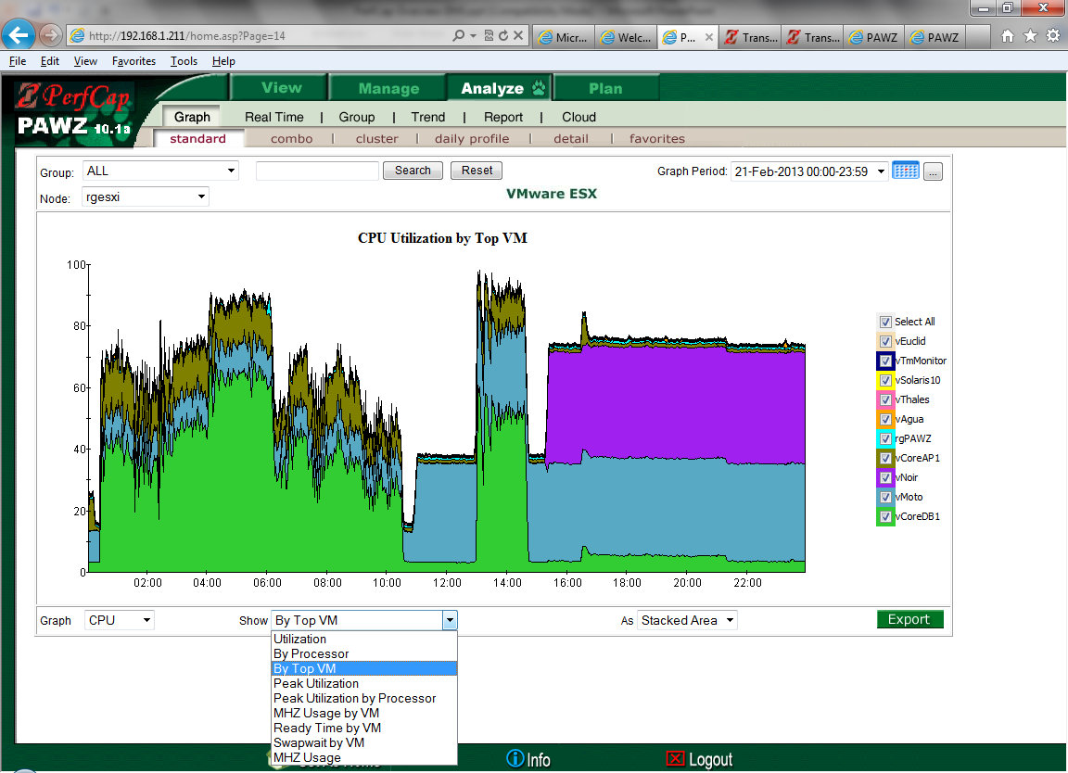
VMware Host data

Slide 18
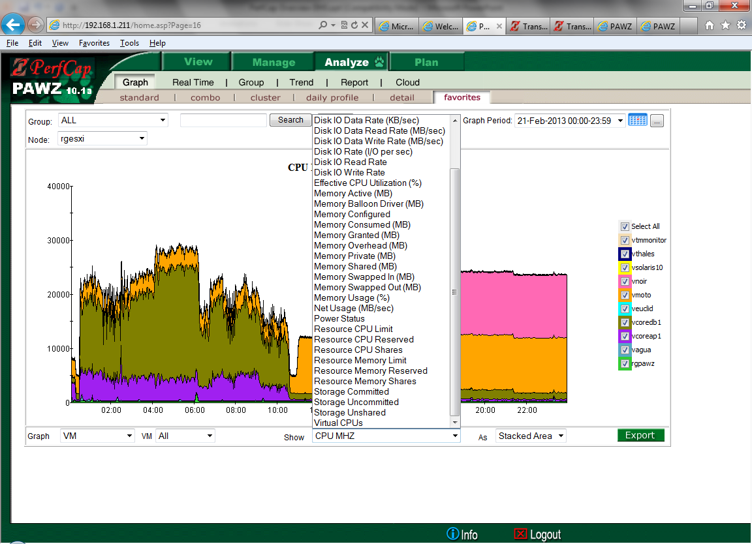
VMware: Per Guest Data

Slide 19
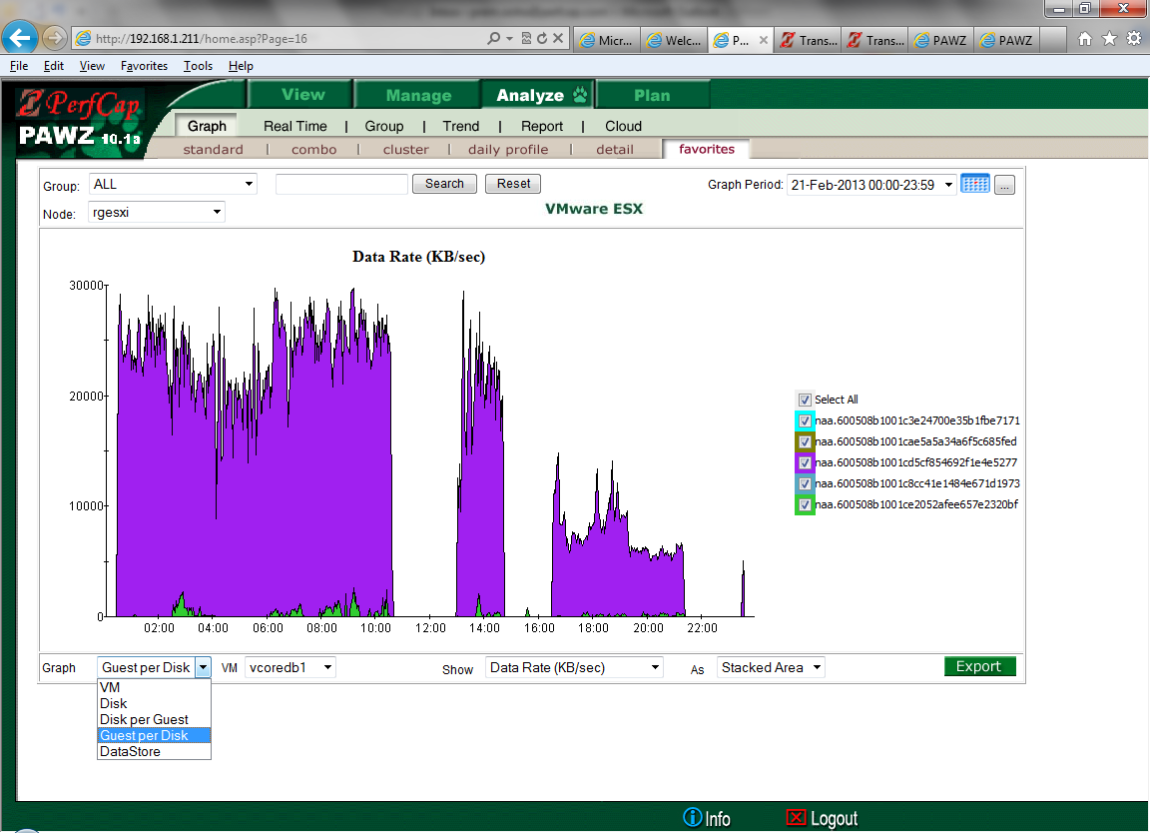
Guest per Disk

Slide 20
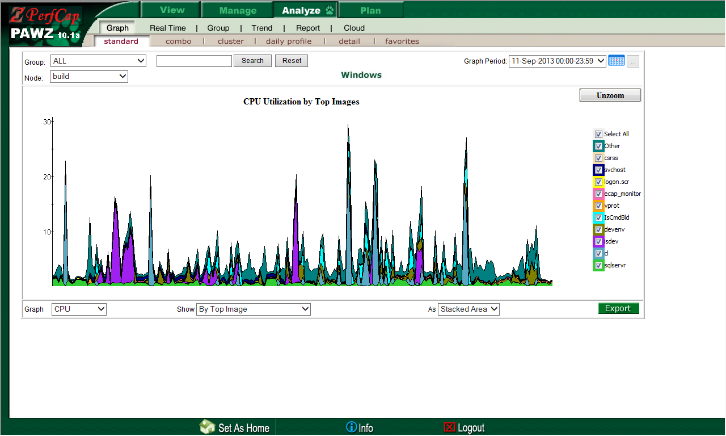
Navigating Through Reports CPU by Process

Slide 21
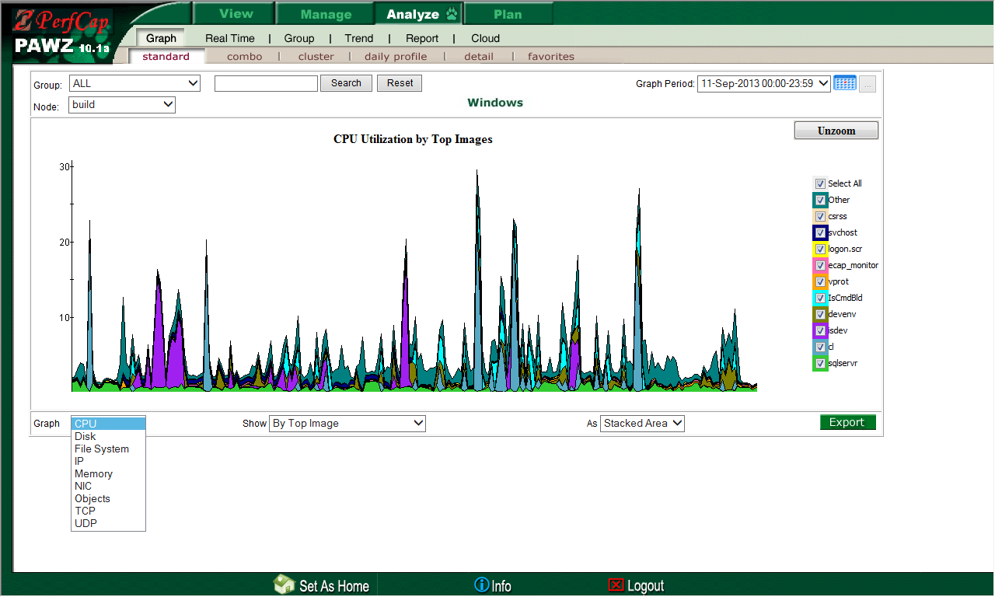
Navigating Through Reports Select Other Performance Metrics

Slide 22
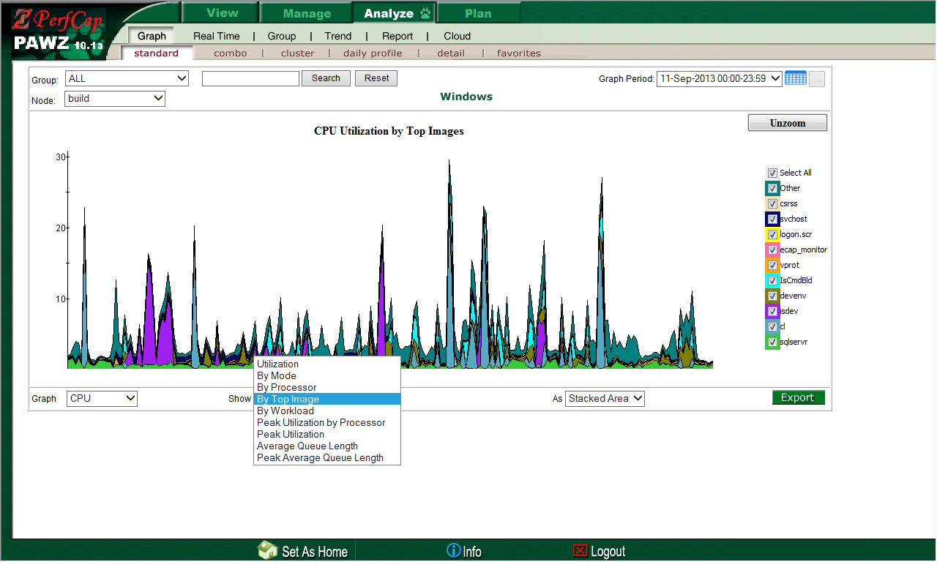
Navigating Through Reports Select Other Performance Sub-Metrics

Slide 23
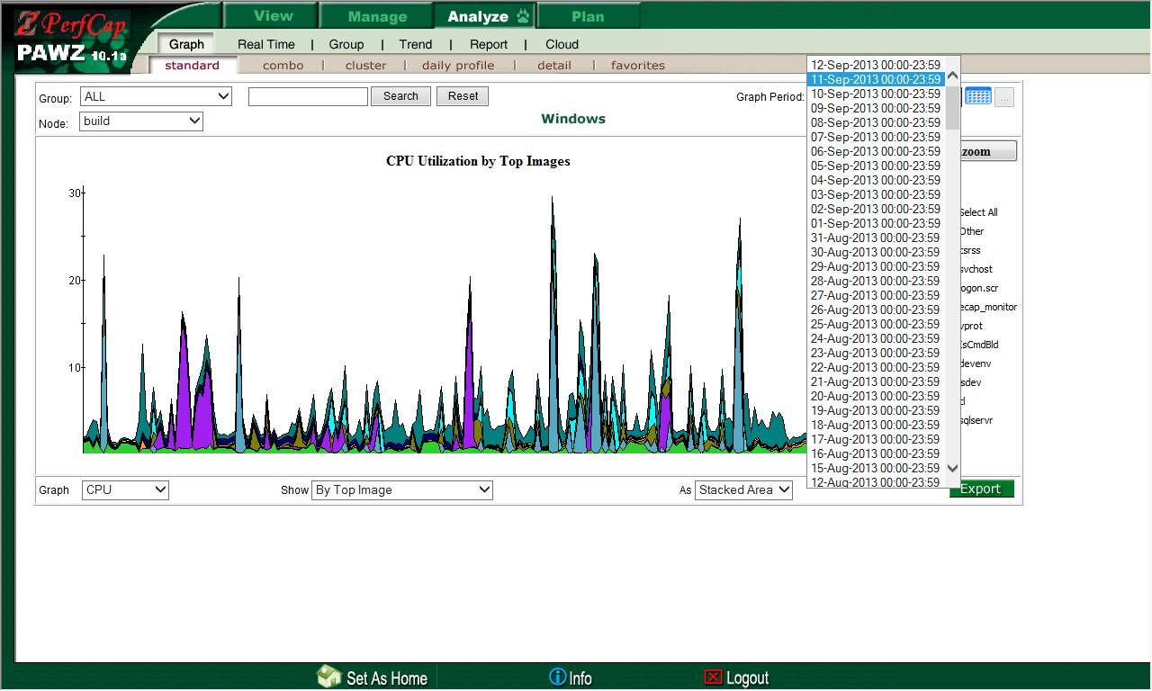
Navigating Through Reports Select Any Historical Date

Slide 24
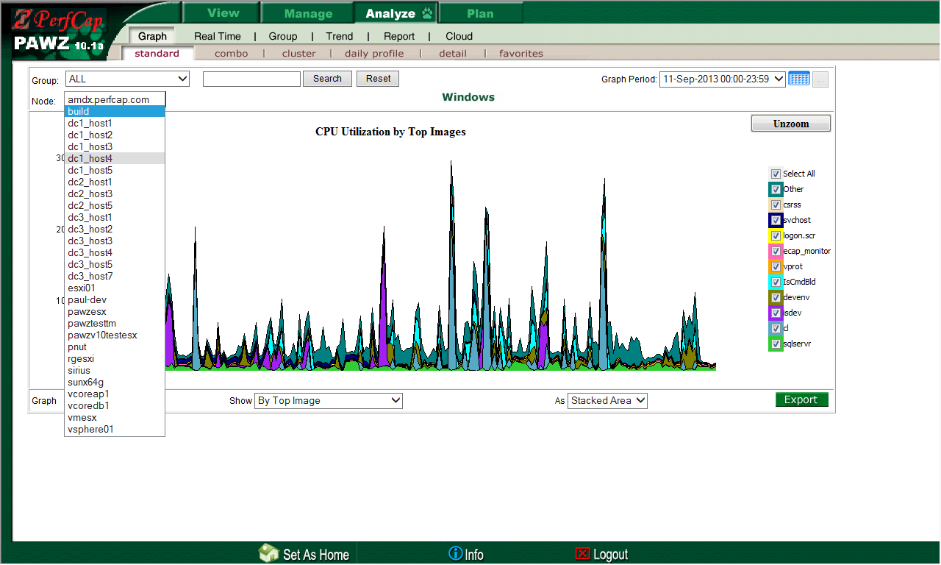
Navigating Through Reports Select Any Server Within A Group

Slide 25
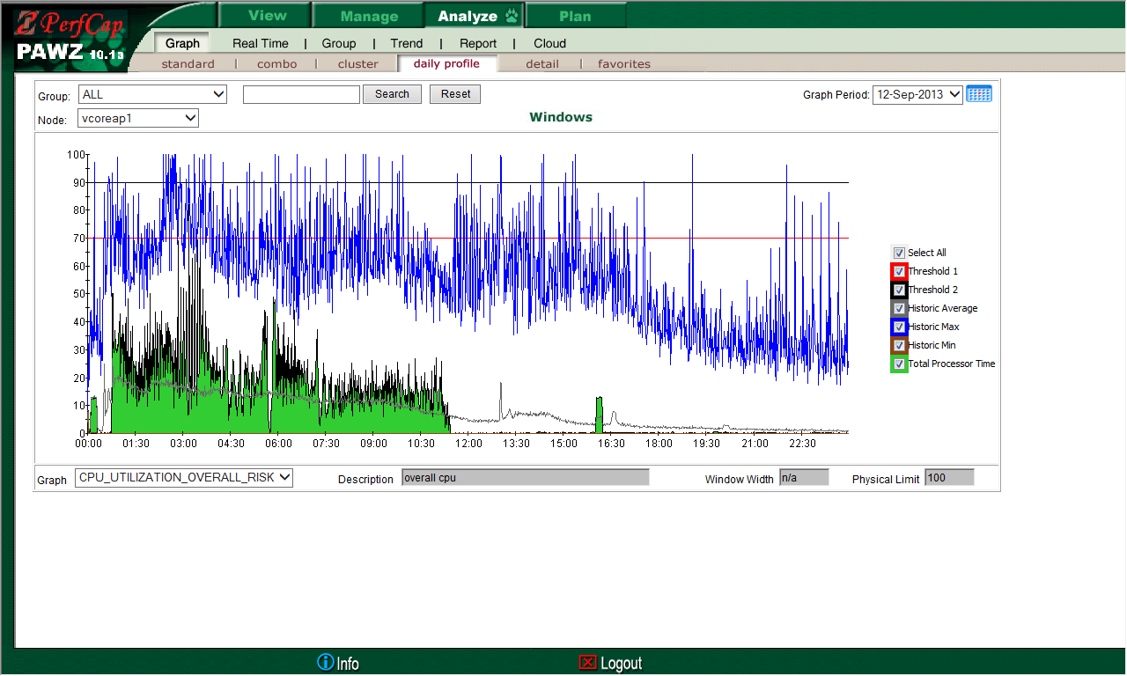
Navigating Through Reports Daily Profile: Compare A Day With Historic Min, Max, Av.

Slide 26
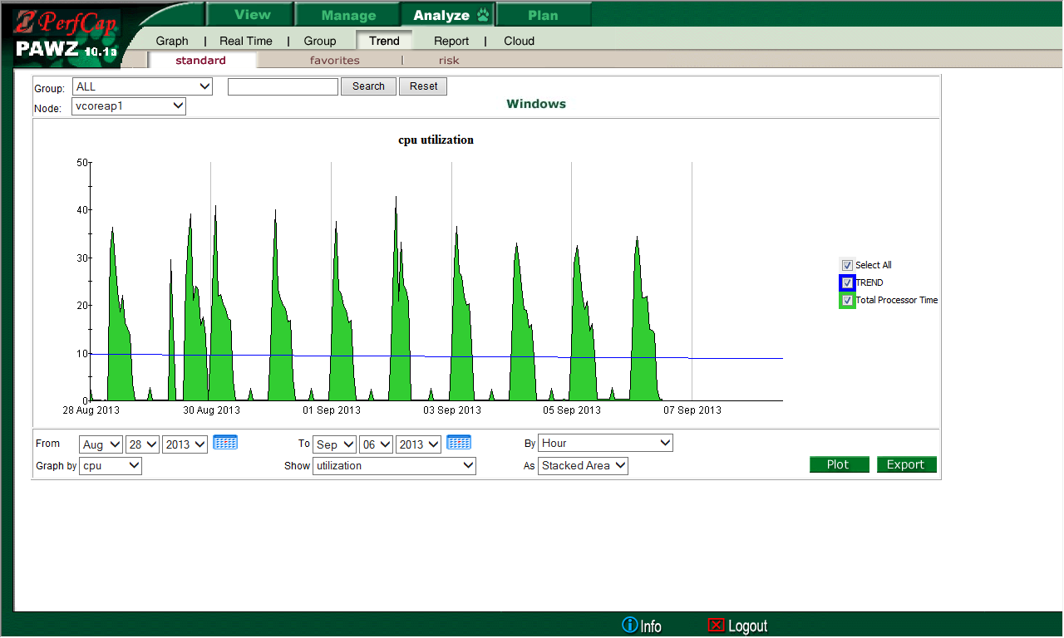
Navigating Through Reports Historic Trend.

Slide 27
AWS EC2 Instances Performance Issues
CPU availability
Memory exhaustion
Storage subsystem performance
PAWZ is able to monitor EC2 instances

Slide 28
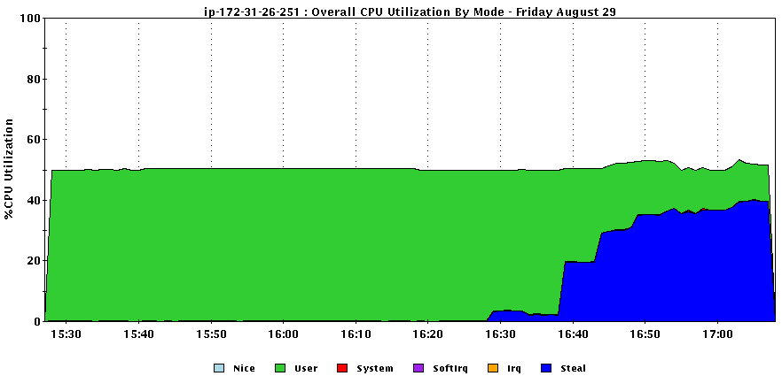
CPU Availability
t2.micro instance: CPU cycle starvation

Slide 29
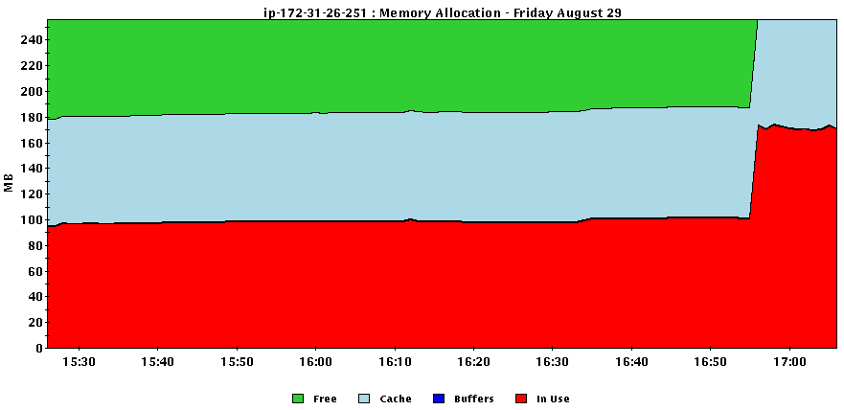
Memory Exhaustion

Slide 30
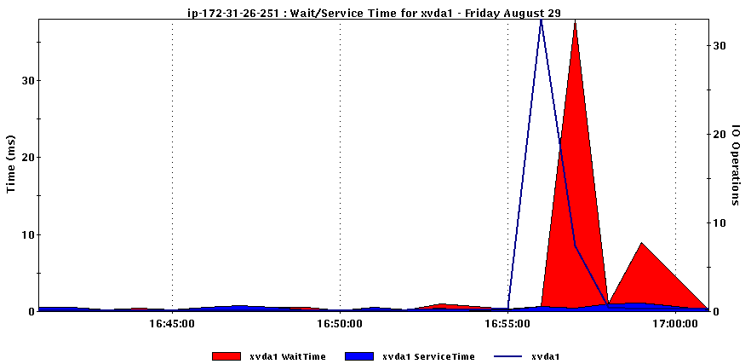
Storage Subsystem Performance

Slide 31
Notifications
Real Time
Daily
Risk Analysis
Interactive Web Reports
E-mail

Slide 32
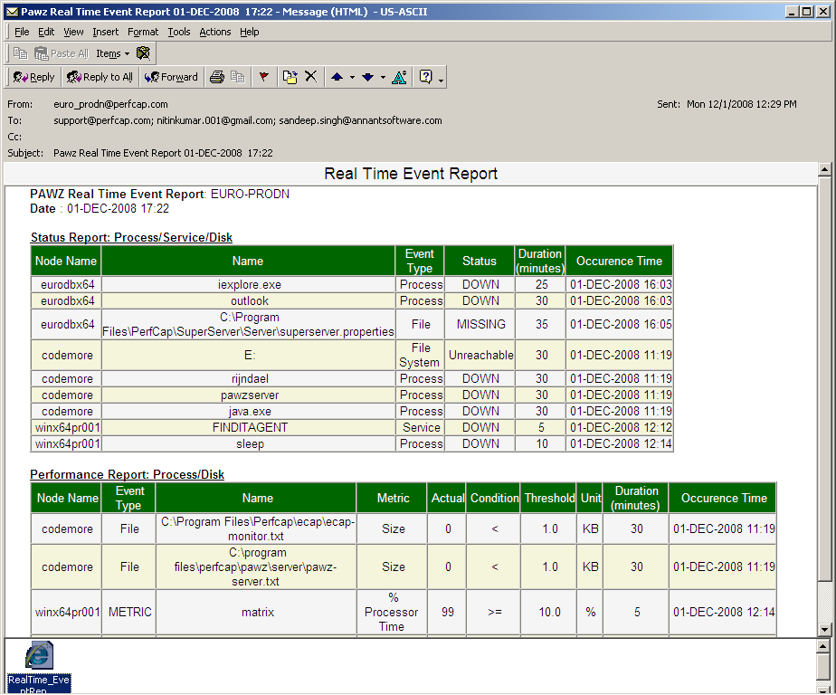
Real Time Event Report

Slide 33
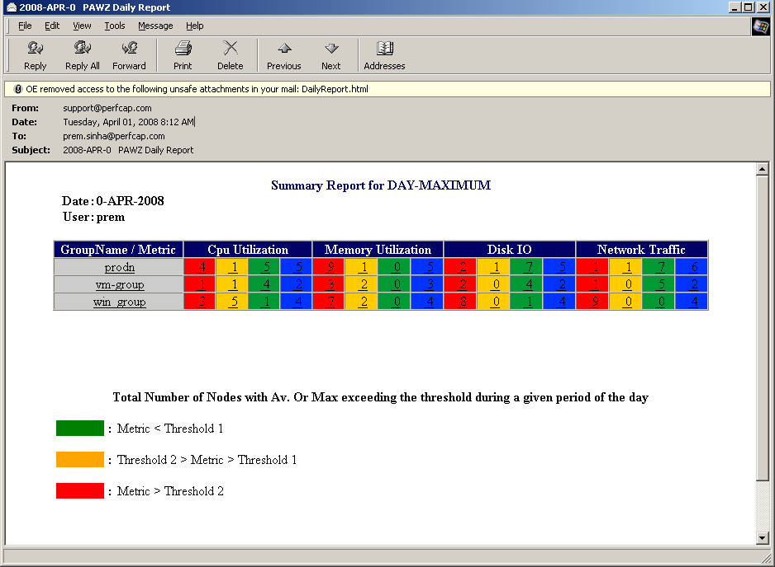
Daily e-mail Reports Summary

Slide 34
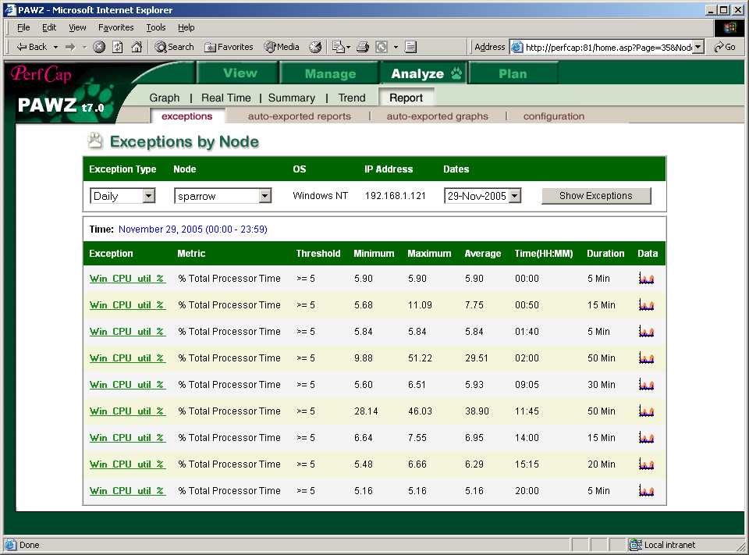
Exception Report

Slide 35
Risk Analysis
Automatically analyze and identifying
servers that are at risk
On a daily basis!!

Slide 36
Risk Analysis Methodology Using Trending
Capacity Limit
Performance Metric (Av. or Peak CPU Utilization)
Today
Remaining Capacity
J F M A M J J A S O N D
Time

Slide 37
Risk Analysis
Physical limit
Breakthrough threshold
Metric
Lead time
Lead time
Time

Slide 38
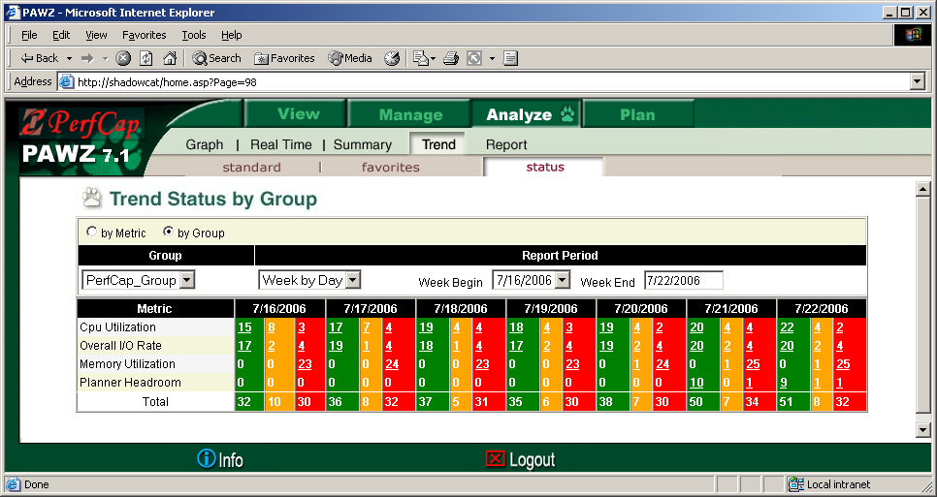
Risk Analysis Report

Slide 39
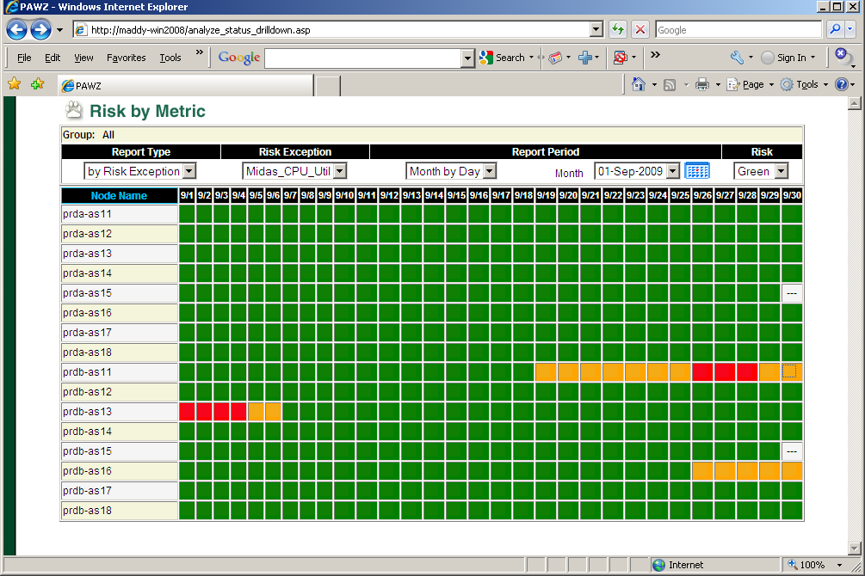
Risk Analysis Report

Slide 40
Capacity Planning via Trending
Capacity Limit
Performance Metric (Av. or Peak CPU Utilization)
Today
Remaining Capacity
J F M A M J J A S O N D
Time
Simple to produce and follow
Issues
defining right Capacity Limit
single vs composite metric
end user satisfaction

Slide 41
PAWZ Planner
Where do you want to operate?
Response Time = Σ{Service Time + Queuing Time}
Response Time
Headroom
Saturation Point
Current Workload
λ
Workload

Slide 42
Capacity Planning via Modeling
Steps:
Data Collection
Identifying Peak Interval(s)
Workload Characterization
Model Validation
Saturation Analysis
All above steps are done automatically each day
“What If” Analysis

Slide 43
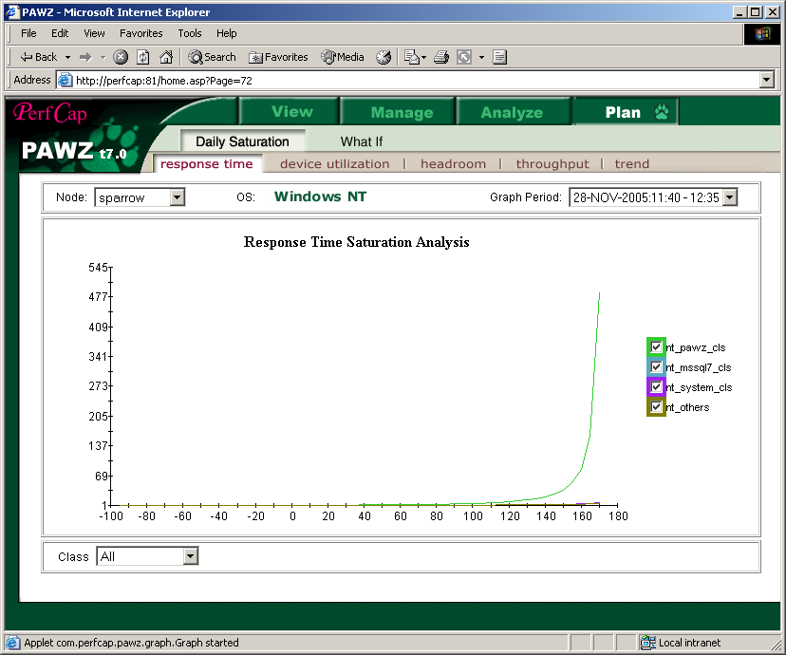
PAWZ Planner

Slide 44
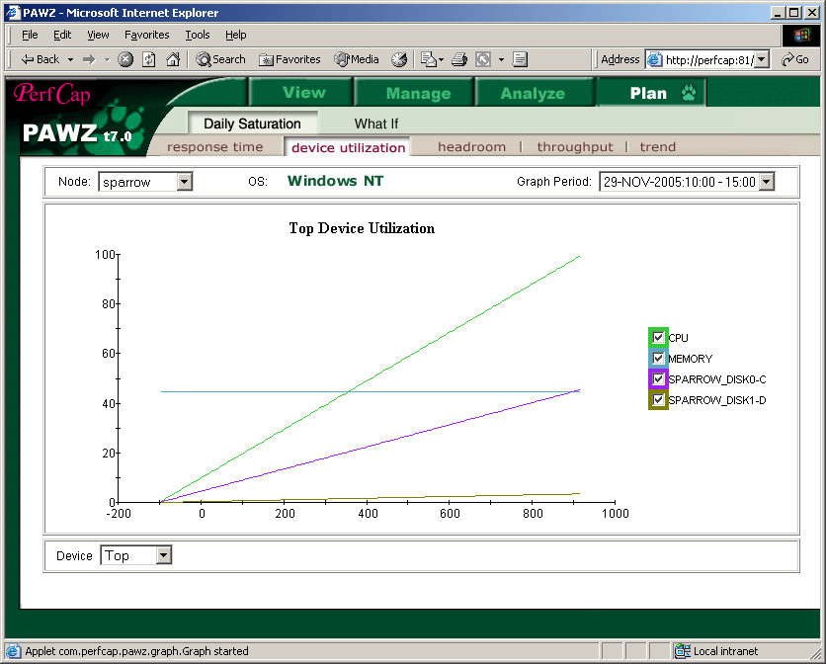
Device Utilization Bottleneck Analysis

Slide 45
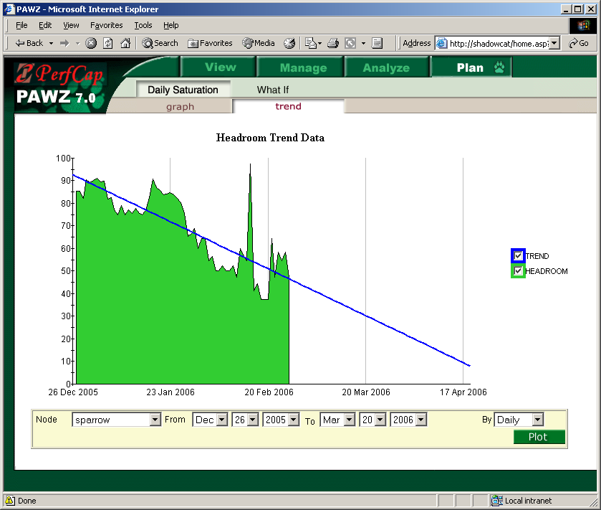
Remaining Headroom (Capacity) Trend

Slide 46
Headroom Risk Analysis
Headroom reaches 0
Headroom crosses threshold
Current state
Headroom
Lead time
Lead time
Headroom threshold
Time
Red status – system within lead time of exhausting capacity.
Amber status – system within lead time of dropping below headroom threshold.

Slide 47
Risk Analysis

Slide 48
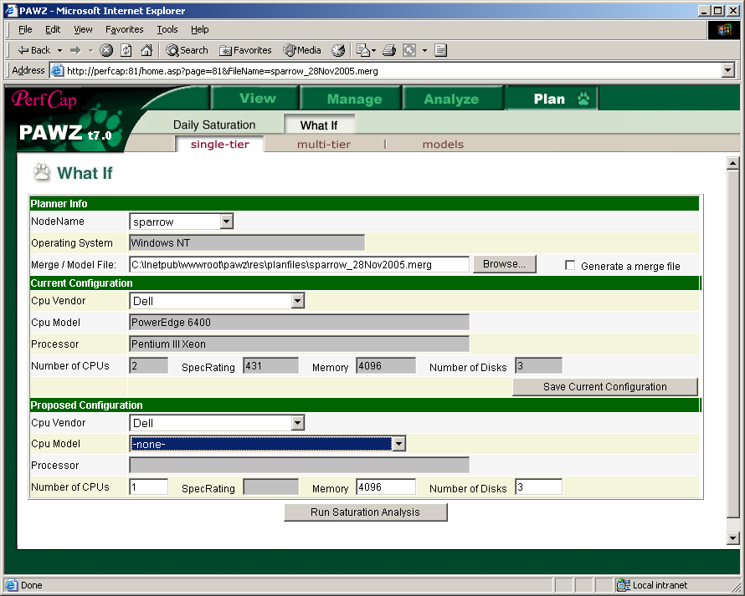
“What if”

Slide 49
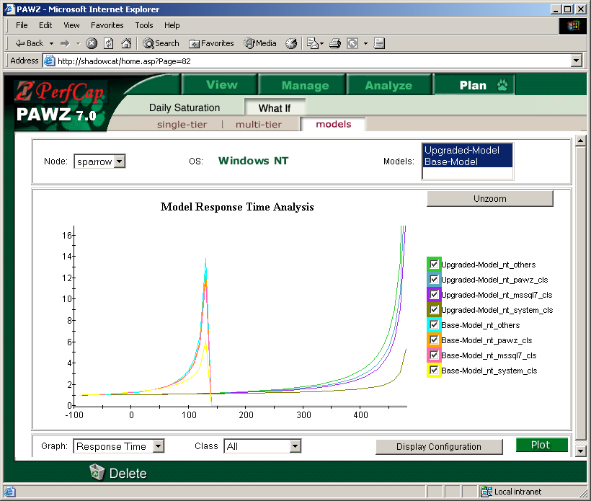
“What if” CPU Upgrade
After
Before

Slide 50
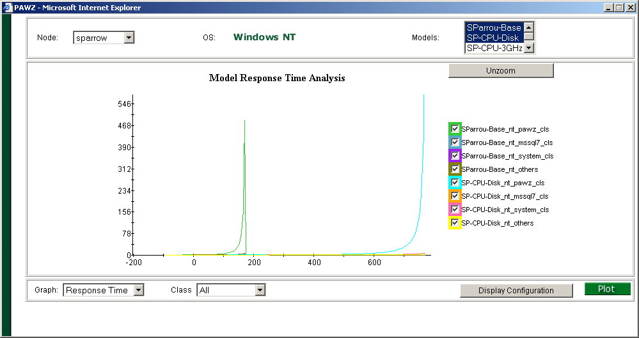
“What if” CPU & Disk Upgrade
After
Before

Slide 51
Capacity Planning Issues
Virtual Environment
Server Consolidation
Load balancing between
Hosts,
Clusters (?)
Data Centers

Slide 52
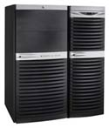
Server Consolidation
FTP
Virtualized Environment
Database
Consolidated Server
E-mail
E-mail
Database
FTP
Physical Servers

Slide 53
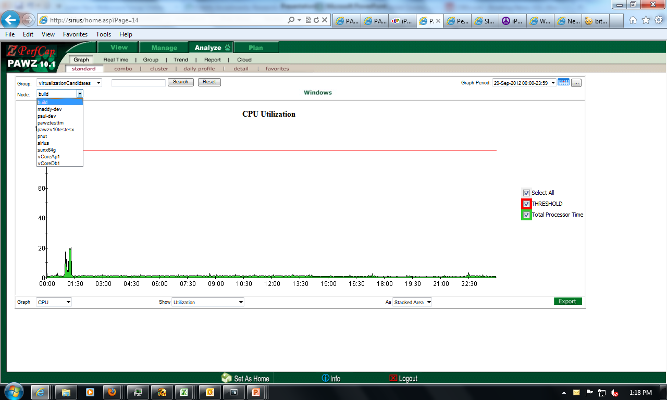
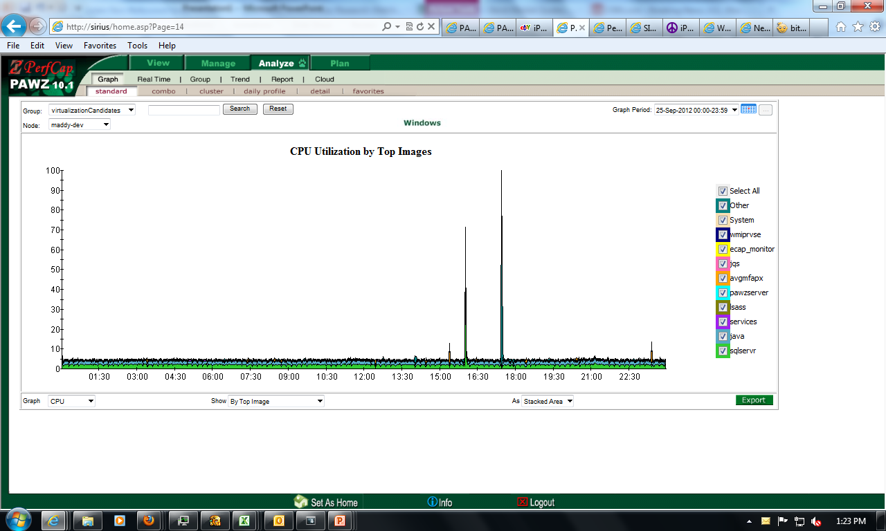
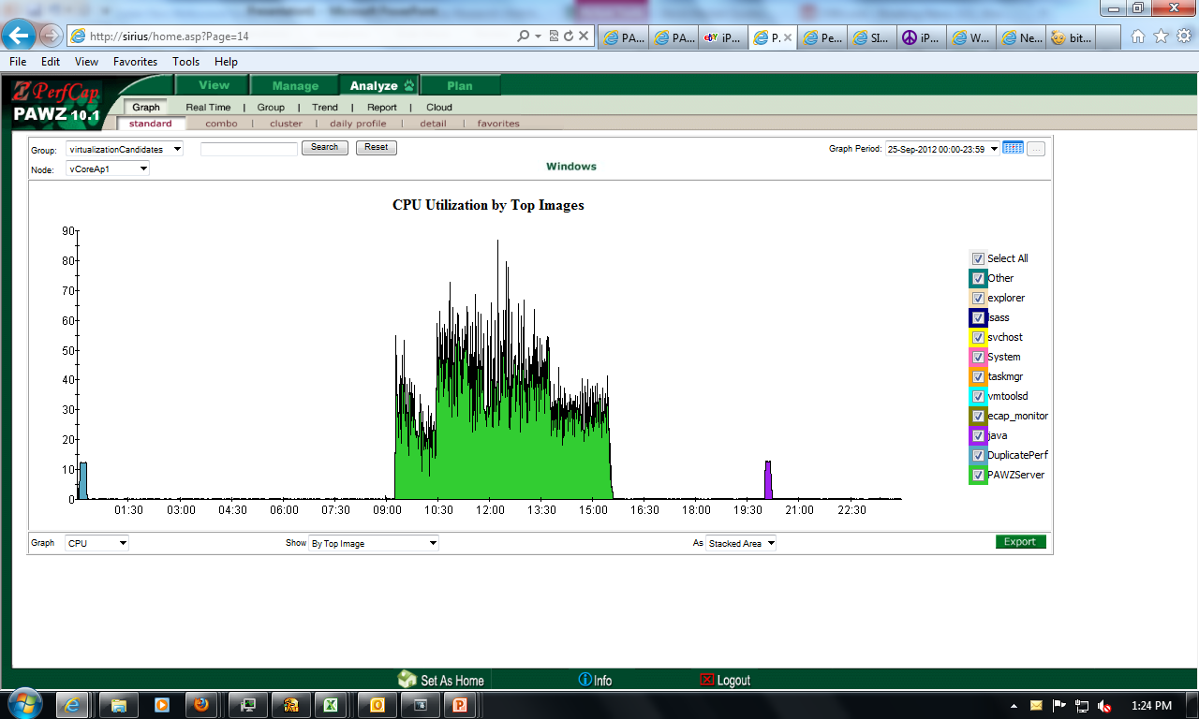
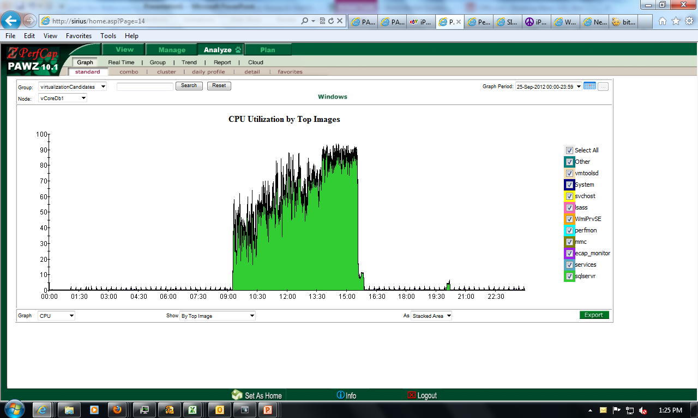
Sample Servers to be Consolidated
Virtualization Candidates
Build
Maddy-Dev
Paul-Dev
Pawztesttm
Pawzv10testesx
Pnut
Sirius
vCoreAp1
vCoreDb1

Slide 54
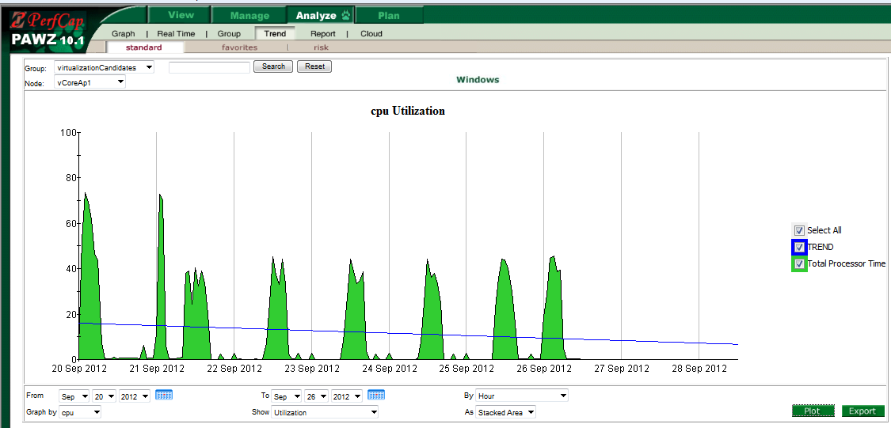
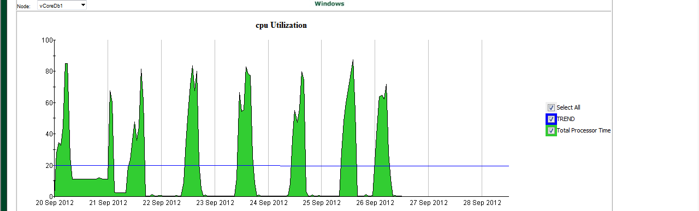
Sample Servers to be Consolidated Trend Data
Virtualization Candidates
Build
Maddy-Dev
Paul-Dev
Pawztesttm
Pawzv10testesx
Pnut
Sirius
Sun64g
vCoreAp1
vCoreDb1

Slide 55
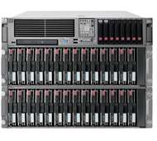
Current and Consolidated Servers Configuration
vCoreAp1 ProLiant DL180 G6 (2.93 GHz, Intel Xeon); 4GB
vCoreDb1 ProLiant DL180 G6 (2.93 GHz, Intel Xeon); 8GB
ConsolidatedSrv ProLiant DL360p Gen8 (3.30 GHz, Intel Xeon); 48GB

Slide 56
vCoreAp1 & vCoreDb1 Consolidation
Click

Slide 57
Server Consolidation
Disks are saturated

Slide 58
Server Consolidation Add more LUNs

Slide 59
Server Consolidation Add more Servers

Slide 60
Server Consolidation Add more LUNs

Slide 61
Consolidated Virtual Machine
Build
Maddy-Dev
Paul-Dev
Pawztesttm
Pawzv10testesx
Pnut
Sirius
Sun64g
vCoreAp1
vCoreDb1
ConsolidatedSrv ProLiant DL360p Gen8 (3.30 GHz, Intel Xeon); 48GB

Slide 62
Balancing Guests between Clusters

Slide 63
VMware Load Balancing

Slide 64
VMware Load Balancing Add more LUNs
15

Slide 65
VMware Load Balancing Balance Host Load

Slide 66
VMware Load Balancing Balance Host Load

Slide 67
VMware Load Balancing Move VMs/Guests

Slide 68
VMware Load Balancing Move VMs/Guests

Slide 69
VMware Load Balancing Move VMs/Guests between Clusters

Slide 70
VMware Load Balancing Move VMs/Guests between Clusters

Slide 71
Basic Pricing
PAWZ Server – License US$25,000; Support US$5,500
PAWZ Clients
Windows: License US$450; Support US$175
Linux: License US$725; Support US$265
Unix: License US$900; Support US$330
Note: Volume discount and other packages are available.
Typical License and one year support for an enterprise with 50 Windows server will be US$61,750 List.

Slide 72
Summary
PerfCap offers an integrated Performance Management and Capacity Planning Software that is:
Out-of-the-box (no scripting required)
Fully automated
Multi-Platform
Web based
Highly scalable
Pricing
Independent of number and class of CPUs in a server
Independent of number of users/seats.

Slide 73
More Information
Sales
Info@PerfCap.com
Web site
www.PerfCap.com
Hot Line
603-594-0222

